Slide 1


DEVELOPMENT OF INTEGRATED WEARABLE DEVICE FOR REMOTE MONITORING OF PREGNANT WOMEN IN GHANA
Project Supervisor
Dr. Godfrey Mills
Co-Supervisor
Prof. Elsie Effah Kaufmann
Group Members
Owoh Einsteina Ofunne - 10943874
Anane George Nyarko – 10947340
Adika Nathaniel - 10957036
DATE: 6th December,2024
UNIVERSITY OF GHANA

Slide 2

TASKS FOR THE WEEK
INTRODUCTION
PROBLEM TO BE SOLVED
OBJECTIVES
EXISTING SOLUTIONS DONE AROUND THE PROBLEM
PROPOSED SOLUTION

Slide 3
INTRODUCTION
Intro…..

Slide 4
PROBLEM DEFINITION
Problem…..

Slide 5

EXISTING WORKS
TITLE : A Comprehensive Framework for Wearable Module for Prenatal Health Monitoring and Risk Detection(2024) [1]
PROBLEM : Lack of a prenatal health monitoring system which has led to high maternal mortality ratio in Bangladesh.
METHODOLOGY :

Slide 6
EXISTING WORKS
RESULTS :
Temperature Measurement : Mean Squared Error(MSE) of only 0.0035
Oxygen Saturation and Heart Rate :MSE of 1.1 and 2.45 respectively.
Blood Pressure: Mean Average Percentage Error(MAPE) of 4.54% for systolic blood pressure and diastolic blood pressure is 5.43%.
Glucose Blood Level : MAPE of 4.77%
AUTHORS : Tabassum et al

Slide 7
EXISTING WORKS
CONCLUSION: A vitals sign monitoring system with innovative features of fall detection and fetal movement tracking.
STRENGTHS: The values obtained from the wearable device compared to commercial devices goes to show the high level of accuracy of the system.
GAP : No integration of AI for predictive analysis of patients vitals to forewarn a risk of complication or possible illness of mother.

Slide 8
EXISTING WORKS
TITLE : Wearable Technology Model to Control and Monitor Hypertension during Pregnancy(2024)
PROBLEM : Hypertension being the second cause of maternal deaths and preterm births in Peru
AUTHOR : Lopez et al

Slide 9
EXISTING WORKS
METHODOLOGY :
RESULTS : The number of controlled patients was increased by 11% and the rate of maternal deaths was reduced by 7% in Lima, Peru

Slide 10
EXISTING WORKS
CONCLUSION: The wearable captures blood pressure, heart rate and patient steps and an alert is sent to health care providers and patient in event of high blood pressure.
STRENGTHS: There is analysis of data collected to help deploy new strategies to monitor and treat patients effectively.
GAP : Data Security measures are not implemented.

Slide 11
EXISTING WORKS
TITLE : Fetal Heart Rate and Kicking Monitoring System for Pregnant Woman (2024)
PROBLEM : High Mortality Rate of Pregnant Women due to premature fetus and improper diagnosis of the fetus in the last trimester of pregnancy.
Authors : Pratheesh et al

Slide 12
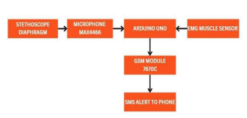
EXISTING WORKS
METHODOLOGY :

Slide 13
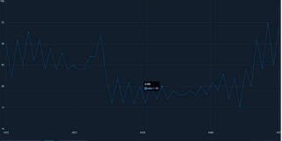
EXISTING WORKS
RESULTS: DIAGRAM INDICATING FETAL HEARTBEAT

Slide 14
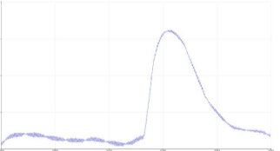
EXISTING WORKS
RESULTS: DIAGRAM INDICATING KICK BY FETUS

Slide 15
EXISTING WORKS
RESULTS: Whenever the heartbeat of the baby falls within the range of – 2 or +2, it detects a hypoxia situation which is very dangerous for the baby.
CONCLUSION: The proposed system monitors fetal health
and sends alert to healthcare providers in case of potential issues.

Slide 16
EXISTING WORKS
STRENGTHS : Highly ergonomic and alarm system for timely intervention in event of emergency.
GAP:
Data Security
Signal Interference and Noise

Slide 17
EXISTING WORKS
TITLE : Long-Term IoT-Based Maternal Monitoring: System Design and Evaluation (2021)
PROBLEM : Late detection of abnormalities leading to pregnancy-complications, injuries and maternal and fetal deaths.
AUTHOR : Sarhaddi et al

Slide 18
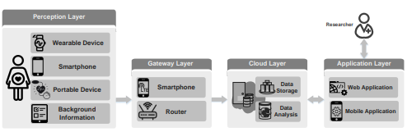
EXISTING WORKS
METHODOLOGY :

Slide 19
EXISTING WORKS
RESULTS :
Averagely, participants used the smartwatch 17.01 ± 4.20 h/day during pregnancy and 13.72 ± 5.71 h/day in postpartum
Average application usage for answering daily questions was 67.5% of the days in pregnancy and 57.0% of the days in postpartum.
Acceptable energy consumption of the watch

Slide 20
EXISTING WORKS
CONCLUSION :
The system consists of data collectors to track stress, sleep, and physical activity of pregnant women.
This pipeline contains deep learning-based quality assessment of data , missing data imputation and anomaly detection.

Slide 21
EXISTING WORKS
STRENGTHS:
Data Security
Machine learning to evaluate changes in vitals monitored
GAP :
Manual Imputation of blood pressure in the app
No risk-prediction of possible pregnancy complications

Slide 22
OBJECTIVES

Slide 23
REFERENCES
[1] T. Tabassum, S. Podder, and S. T. S. Rafid,** "A Comprehensive Framework for Wearable Module for Prenatal Health Monitoring and Risk Detection," 2024 IEEE International Conference for Women in Innovation, Technology & Entrepreneurship (ICWITE), 2024, pp. 283-288, doi: 10.1109/ICWITE59797.2024.10503560.
[2] Abeywardhana, S.A.Y.; Subhashini, H.A.A.; Wasalaarachchi, W.A.W.S.; Wimalarathna, G.H.I.; Ekanayake, M.P.B.; Godaliyadda, G.M.R.I.; Wijayakulasooriya, J.V.; Rathnayake, R.M.C.J. Time Domain Analysis for Fetal Movement Detection Using Accelerometer Data. In Proceedings of the 2018 IEEE Region 10 Humanitarian Technology Conference (R10-HTC), Malambe, Sri Lanka, 6–8 December 2018; pp. 1–5

Slide 24
REFERENCES
[3] J. B. Pitt, S. Zeineddin, M. Carter et al., “Using consumer wearable devices to profile postoperative complications after pediatric appendectomy,” Journal of Surgical Research, 2023.
[4] H. M. Ghomrawi, B. T. Many, J. L. Holl et al., “Clinicians' perspectives on wearable sensor technology as an alternative bedside monitoring tool in two West African countries, ” International Journal of Medical Informatics, vol. 175, article 105046, 2023.
[5]H. Akoglu, “User's guide to correlation coefficients, ” Turkish Journal of Emergency Medicine, vol. 18, no. 3, pp. 91 –93, 2018.

Slide 25
MISCELLANEOUS
QUESTIONS/FEEDBACK

